Slide 1

INSIGHTS FROM ONLINE RETAIL DATASET FROM TCS - FORAGE
DURGA PRABHAKARAN

Slide 2
INTRODUCTION
I’m Durga Prabhakaran and I’m here to present the data insights derived from the dashboard created using the online retail dataset for Forage – TCS Data visualisation project.

Slide 3
Question 1
The CEO of the retail store is interested to view the time series of the revenue data for the year 2011 only. He would like to view granular data by looking into revenue for each month. The CEO is interested in viewing the seasonal trends and wants to dig deeper into why these trends occur. This analysis will be helpful for the CEO to forecast for the next year.

Slide 4
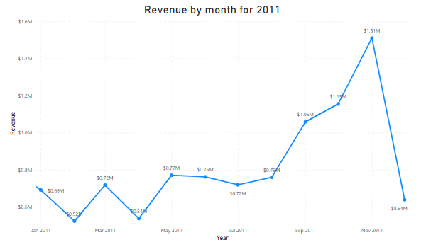

According to the statistics, the first eight months of sales from January to August were very stable, with an average of $685K (Six hundred eighty-five thousand US dollars) in revenue per month. The increase in revenue begins in September, when it grows by 40% over the previous month. This pattern persisted up until November, when it rose to 1.5 million US dollars, the largest amount of the whole year.
Unfortunately, since the data for December is insufficient, no inferences can be made from it. This research demonstrates how seasonality—which generally happens in the last four months of the year—affects retail store sales

Slide 5
QUESTION 2
The CMO is interested in viewing the top 10 countries which are generating the highest revenue. Additionally, the CMO is also interested in viewing the quantity sold along with the revenue generated. The CMO does not want to have the United Kingdom in this visual.

Slide 6
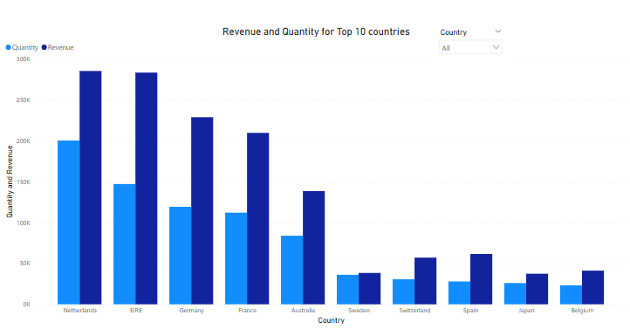

The top 10 countries with the most potential for growth are represented in the second graph. Since the UK already has a large demand and I understand you are more interested in nations where demand may be boosted, the UK is not included in these statistics. According to the data, sales of units and income are quite high in nations like the Netherlands, Ireland, Germany, and France. To guarantee that steps are taken to further seize these markets, I would propose concentrating on these nations.

Slide 7
QUESTION 3
The CMO of the online retail store wants to view the information on the top 10 customers by revenue. He is interested in a visual that shows the greatest revenue generating customer at the start and gradually declines to the lower revenue generating customers. The CMO wants to target the higher revenue generating customers and ensure that they remain satisfied with their products.

Slide 8
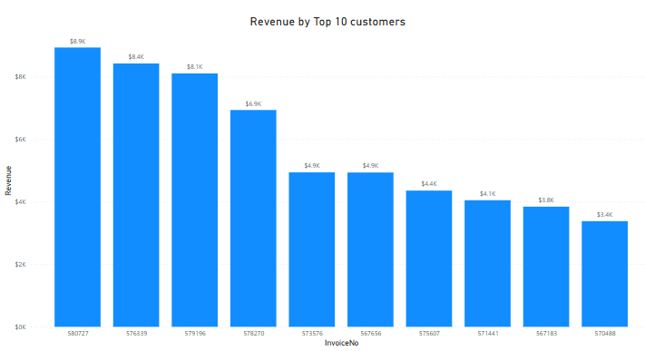
The top 10 consumers who have made the most purchases from the business have been the subject of the third study. According to the statistics, there are not many differences between the top 10 consumer purchases. The fact that the highest revenue-producing consumer only spent 17% more than the second highest demonstrates that the company does not rely solely on a small number of consumers to generate income. This demonstrates that consumers' ability to negotiate is limited and that the state of business is positive.

Slide 9
QUESTION 4
The CEO is looking to gain insights on the demand for their products. He wants to look at all countries and see which regions have the greatest demand for their products. Once the CEO gets an idea of the regions that have high demand, he will initiate an expansion strategy which will allow the company to target these areas and generate more business from these regions. He wants to view the entire data on a single view without the need to scroll or hover over the data points to identify the demand. There is no need to show data for the United Kingdom as the CEO is more interested in viewing the countries that have expansion opportunities.

Slide 10
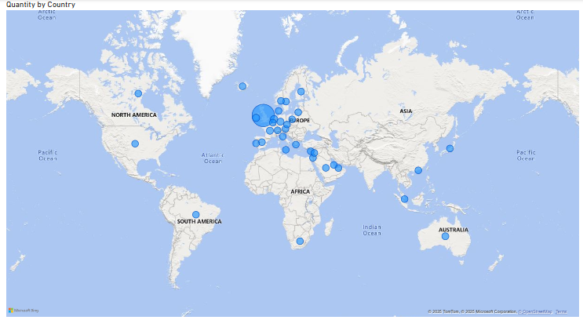
The map chart concludes by comparing the places that have produced the greatest revenue to those that have not. Apart from the UK, it is clear that nations like the Netherlands, Ireland, Germany, France, and Australia generate large profits, and the company should invest more in these nations to boost product demand. The map also reveals that the majority of sales occur only in the European zone, with only a small number in the American region. Along with Russia, there is no market for the items in Africa or Asia. Sales revenues and profitability might increase with the implementation of a fresh strategy focused on these areas.

Slide 11
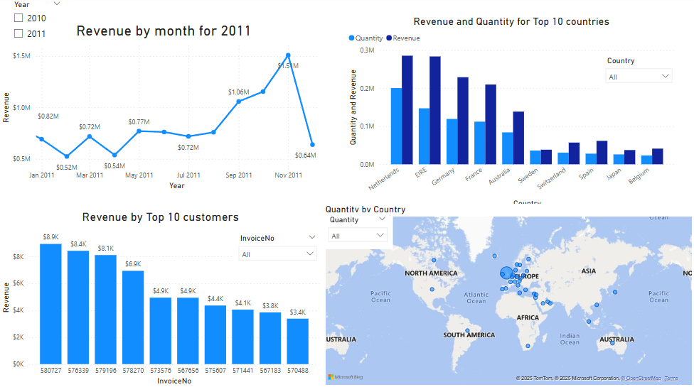
DASHBOARD

